Slide 1
Central Asia Analysis
Python Final Presentation
Team 7

Slide 2



Agenda
1
Region overview
2
Missing values strategy
Analysis strategy
3
Analysis
4
Dropped values and data quality
5

Slide 3












Central Asia
Maldives
Mongolia
Bangladesh
Myanmar
Bhutan
China
Nepal
India
Sri Lanka
Kazakhstan
Tajikistan
Kyrgyzstan
Thailand

Slide 4



Missing values strategy
01
Find same year value
Value from the same year (2017) from the same source.
Value from the same year (2017) from a different source.
02
Find values from different years
If we didn´t find the same year value, we looked into values from different years to predict the missing value:
If the value is from previous year (2016) or year after (2018)
If there are at least 5 values from year 2000 to 2017
Back fill
Median
03
Countries comparison approach
In order to fill the remaining missing values, we designed an approach based on countries comparison:
Find other similar countries to the country with the missing value. Similar= same income level.
Filter those countries to be part of the same region (metadata).
Take values and calculate median.
04
Dismiss values
When using our approach, if we found less than 3 similar countries to compare with, the comparison would not be considered accurate and the missing value will be dismissed.

Slide 5






Analysis strategy
Economy
Population
Wealth
Health
Infrastructure
SPI
Poverty ratio
Poverty ($1.90 /day)
Poverty ($3.20 / day)
Income shares
Health poverty < $3.10
GINI index
Age dependency total
Age dependency old
Age dependency young
Life expectancy
Birth total rate
Birth skilled labour
Fertility total rate
Fertility adolescent
Death rate
HIV rate
Undernourishment
Electricity total
Electricity rural
Electricity urban
Surface area
Mobile per 100
External source
GDP
GDP growth
GDP per capita
Employment agriculture
Employment industry
Employment service
Employment military
Military expenditure
Agriculture value added
Industry value added
Services value added
Merchandise trade
Tax revenue
Total population
Male population
Female population
Population 0-14
Population 15-64
Population 65+
Pop density
Pop growth
Pop largest city
Pop slums
Rural pop
Urban pop
Urban pop growth
Basic human needs
Foundations of wellbeing
Opportunity

Slide 6
ANALYSIS

Slide 7
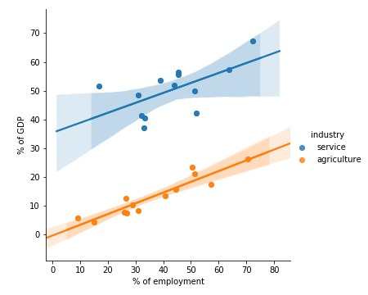





Economy
GDP
Nepal
Services
Agriculture
Industry
Nepal
Sri Lanka

Slide 8
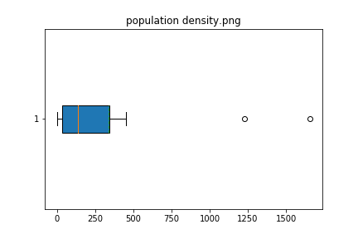

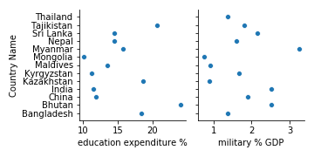
Population and humanitarian facts
Myanmar
Medium low educational expenditure
High military expenditure
Bangladesh
Maldives
Country history causes
Bangladesh
Unexpected outliers in population density
Maldives

Slide 9



Wealth
Wealth distribution
and equality
Poverty
Income
Education
Politics
History
Demographics
Rural vs Urban
Young vs Old
Poverty
Poverty
=
Growth?
Employment
Agriculture
Services
Industry
India
Bangladesh

Slide 10
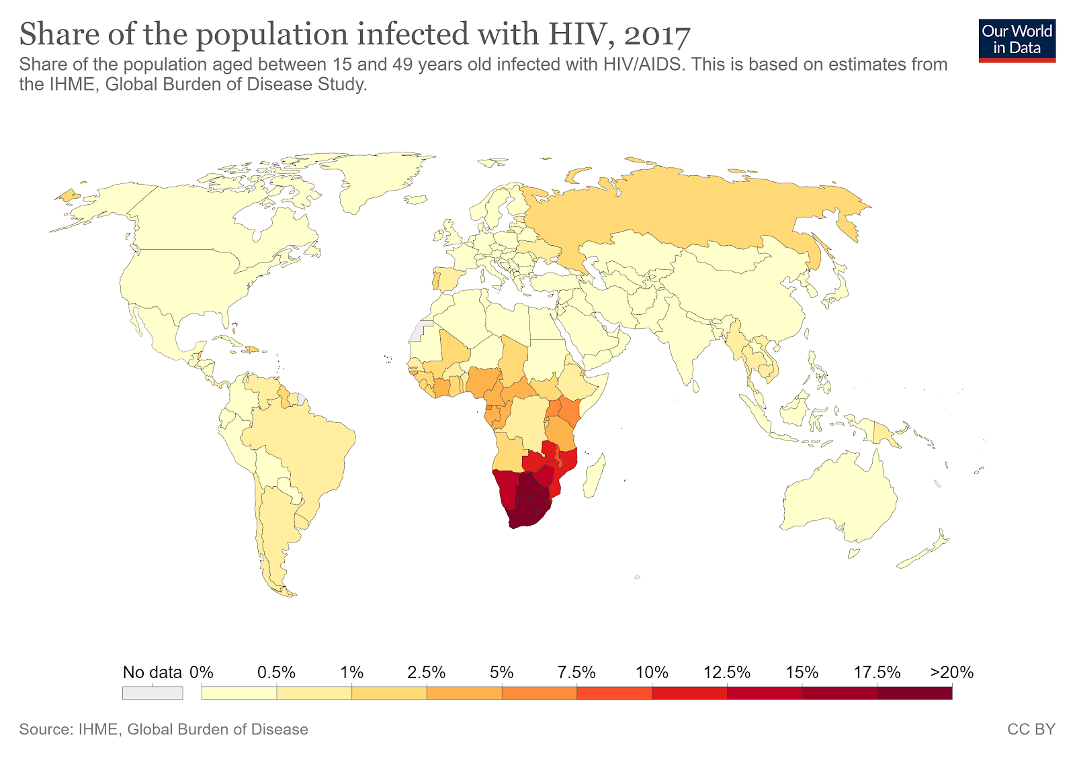


Health
Health - Poverty
Expected correlations
HIV
Reverse regional age correlations
Geolocation as predominant factor

Slide 11
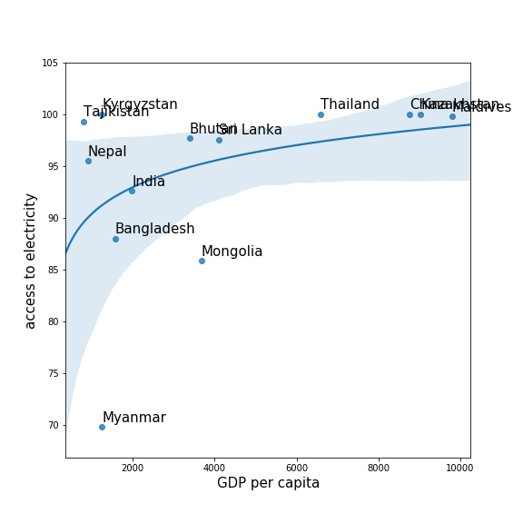

Infrastructure
Kyrgyzstan
Geographic opportunities
Tajikistan
Geographic opportunities
Myanmar
Population density
Nomadic culture of the rural population
Mongolia
Infrastructure

Slide 12
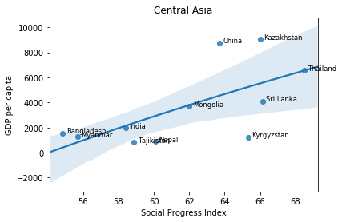


Social Progress Index
What is SPI?
China
High GDP growth
Kazakhstan
Kyrgyzstan
Higher poverty
Low GDP growth
Nepal

Slide 13


Dropped values and data quality
Education
Literacy rate (young)
Poverty line
Not enough data in any of the different
levels of education. This could be due to
different education stages in each country.
Literacy rate in adults (from 15 years
onwards) already covers young rate (from
15 to 24). Unnecessary variable.
Number of people pushed below the $3.10 ($ 2011 PPP) poverty line by out-of-pocket health care expenditure.
Incoherent data, no source.
China
Maldives
Autocratic regimes
Possible manipulated data for trade advantages
2004: Earthquake and Tsunami
High political instability, social unrest.
Possible manipulated data for political reasons

Slide 14






MEET THE TEAM
Team 7
Abby
Antony
Delara
Vafaeinejad
Dongwoo
Kang
Georg
Stotzingen
Marta
Moreno
Victoria
Landa-Steinau
India
Iran
South Korea
Germany
Spain
USA

